Slide 1

EDA on E-retail factors for customer activation and retention
submitted by
Arunprasad.k

Slide 2
WELCOME!
Thank you for coming today!
Customer retention strategies are one of the most effective ways to turn new customers into repeat customers. By creating fresh opportunities for your customers, you can boost the value of each person who purchases from your ecommerce store.

Slide 3


Slide 4
TABLE OF CONTENTS
1
4
INTRODUCTION
CATEGORICAL ENCODING
Before starting our presentation
converting the labels into numeric form
2
5
DATA MINING
FEATURED ENGINEERING
Handling missing values
domain knowledge to extract features
3
6
EDA
CONCLUSION
Exploratory data analysis
the last element of a research paper

Slide 5
INTRODUCTION
Notes:
No slide master

Slide 6
Customer satisfaction has emerged as one of the most important factors that guarantee the success of online store; it has been posited as a key stimulant of purchase, repurchase intentions and customer loyalty.
A comprehensive review of the literature, theories and models have been carried out to propose the models for customer activation and customer retention.
Five major factors that contributed to the success of an e-commerce store have been identified as: service quality, system quality, information quality, trust and net benefit.

Slide 7
5 MAJOR FACTORS THAT CONTRIBUTE THE SUCCESS OF AN E-COMMERCE
FACTOR 2
FACTOR 4
SYSTEM QUALITY
TRUST
FACTOR 5
NET BENEFIT
FACTOR 1
FACTOR 3
SERVICE QUALITY
INFORMATION QUALITY

Slide 8
KEY WORDS
BASIC STATISTICAL
ANALYSIS
Statistical methods involved in carrying out a study include planning, designing, collecting data, analysing, drawing meaningful interpretation and reporting of the research findings.
1
FEATURED ENGINEERING
EXPLORATORY DATA ANALYSIS
3
The goal is to turn data into information, and information into insight.
Exploratory data analysis (EDA) is used by data scientists to analyze and investigate data sets and summarize their main characteristics, often employing data visualization methods
2

Slide 9


TOOLS USED
LIBRARIES USED
Anaconda Navigator 1.9.6
Jupyter Notebook 5.7.4
Analyzing : Numpy,Pandas
Visualization: : Matplotlib, Seaborn

Slide 10
IMPORTING REQUIRED
LIBRARIES
IMPORTING THE DATASET
CLEANING DATASET
EDA ON THE DATASET
IMPLEMENTATION
CONCLUSION

Slide 11
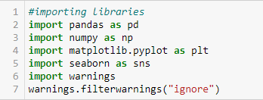
IMPORTING LIBRARIES
IMPORTING DATASET
IMPORTING NECESSARY LIBRARIES

Slide 12
DATA MINING
Notes:
No slide master

Slide 13
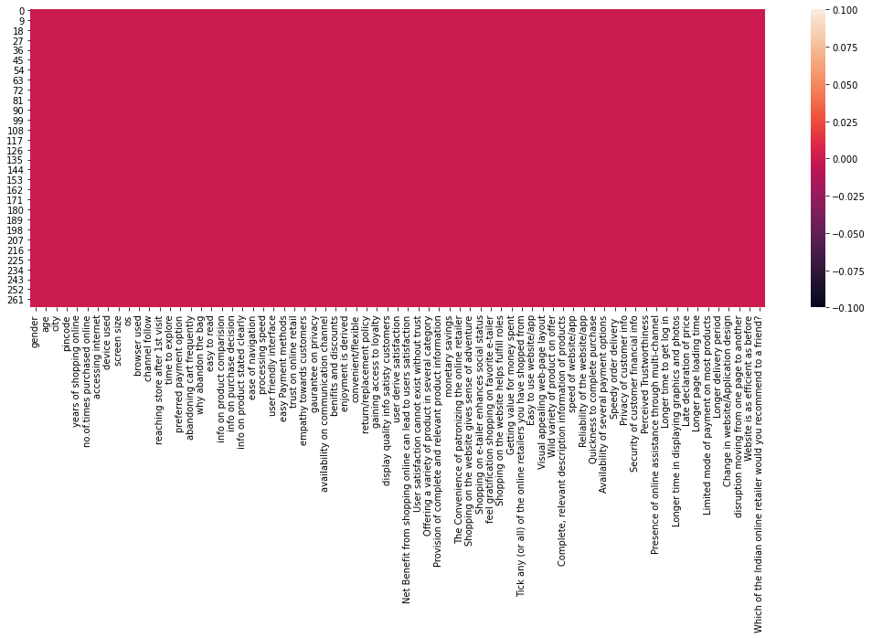
FINDING MISSING VALUES

Slide 14
NO MISSING VALUES
Before applying any type of data analytics on the dataset, the data should be first cleaned.
Here we find there are no missing values in the dataset which needed to be handled in case if any present.

Slide 15
EXPLORATORY DATA ANALYSIS
Notes:
No slide master

Slide 16
Univariate analysis is the simplest form of analyzing data. “Uni” means “one”, so in other words your data has only one variable. It doesn't deal with causes or relationships (unlike regression ) and it's major purpose is to describe
UNI-VARIATE ANALYSIS

Slide 17
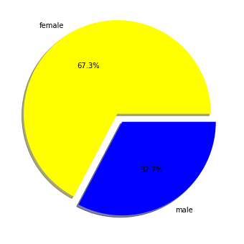
GENDER
The demographics of the respondents showed that the number of females was higher with a share of 68%, while 32% were males.

Slide 18
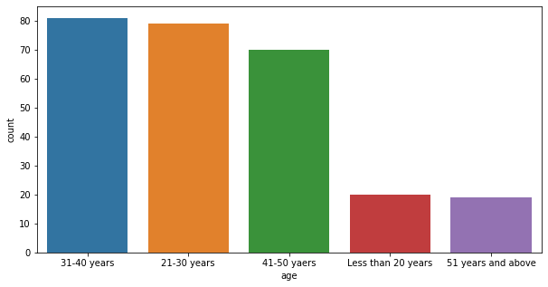
AGE
Here we can see that people of age group between 31-40 years seems to use the online retailing the most when compared to other age groups
whereas the people of age group of less than 20 years and 51 years and above were the least to use online retailing.

Slide 19
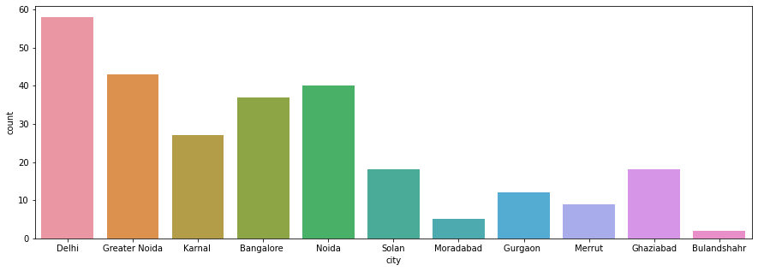
CITY
Regarding city wise the capital of India ”Delhi” placed at the top among other cities with respect to people who shop online from , followed by Bangalore.
The least among them being Bulandshahr

Slide 20
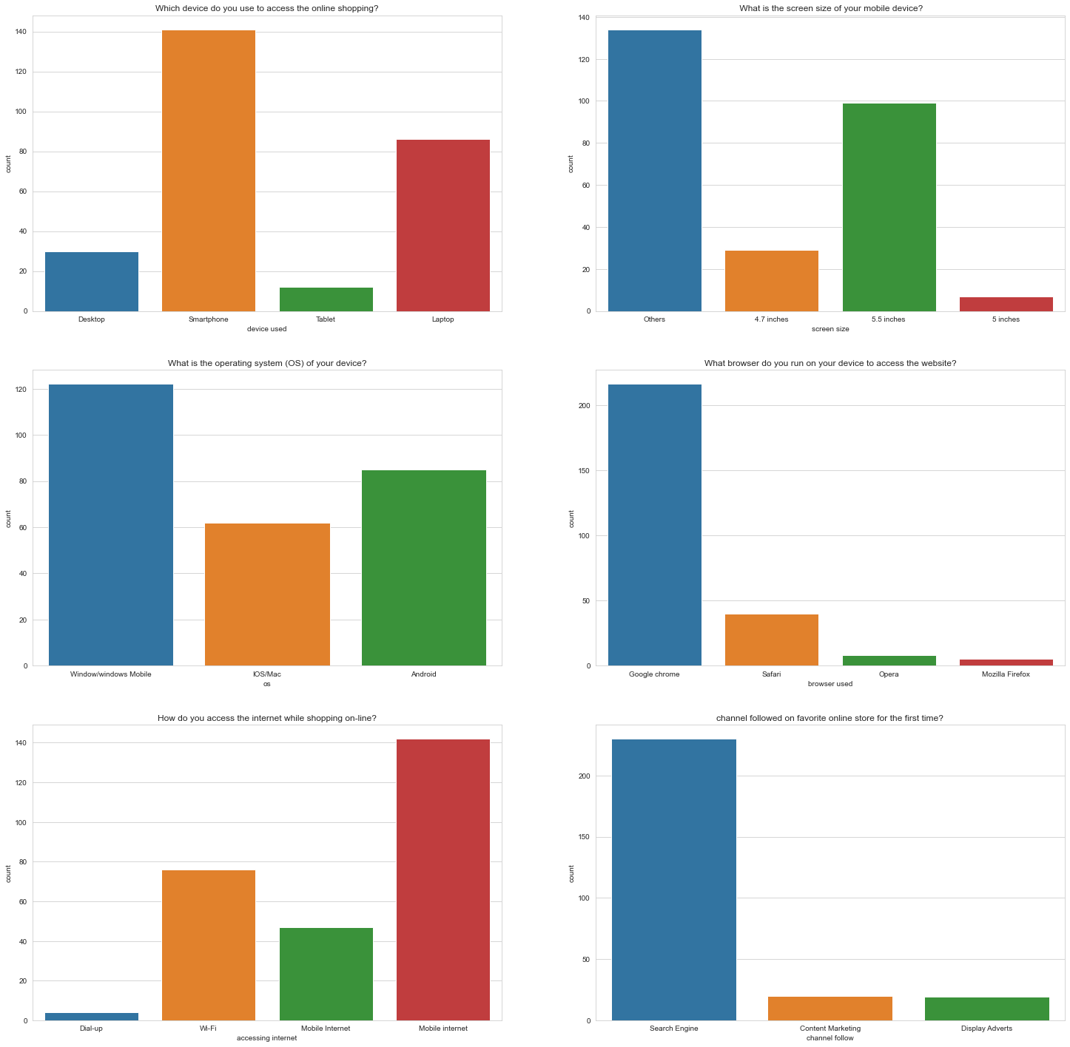
SYSTEM QUALITY
•From the count plot we can infer that the user who use smartphone device were more in number to access the online shopping
•People who uses smartphone prefer a big screen. from the graph we can see that most of the people (around 100) uses the phone with screen size of 5.5 inches.
•Around 120 users use their device with windows/windows mobile as their operating system
•Most people prefer google chrome as the browser while accessing internet
•while accessing internet most people uses mobile internet to access the online shopping websites
•people prefer search engine as the channel followed on favorite online store for the first time. very least prefer the other two

Slide 21
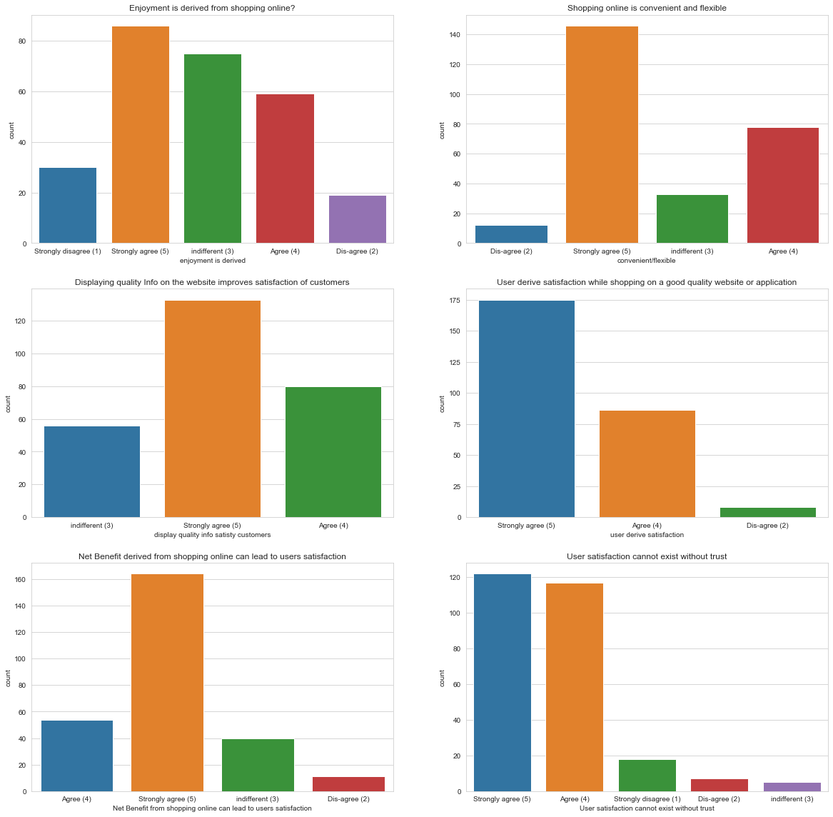
USER SATISFACTION
•Enjoyment is derived from shopping online?- For this question people around 85 in count strongly agree that shopping online gives them enjoyment whereas only 18 person disagree to this opinion
•Shopping online is convenient and flexible?- From the graph we infer that people strongly agree that shopping online is convenient and flexible rather than offline shopping.
•Displaying quality Info on the website improves satisfaction of customers?- The data clearly shows 3 kind of people opt for this statement.In that option around 170 people strongly agree that Displaying quality Info on the website improves their satisfaction

Slide 22
USER SATISFACTION
User derive satisfaction while shopping on a good quality website or application?- From the data we infer that most of the people strongly agree that a good website satisfy them while shopping online.
•Net Benefit derived from shopping online can lead to users satisfaction? - Most of the people strongly agree that they get satisfied by doing online shopping with net benefits
•User satisfaction cannot exist without trust - The count plot clearly shows people mostly believe that User satisfaction cannot exist without trust. Nearly 120 people strongly agree to it where as 115 people chooses agree.

Slide 23
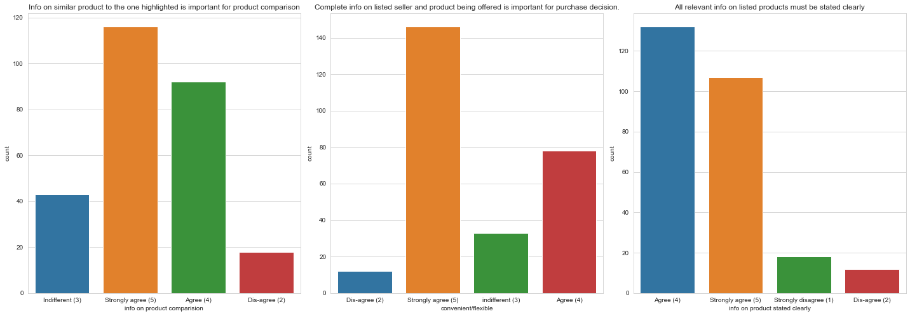
INFORMATION QUALITY
•Most of the respondent strongly agrees that Info on similar product to the one highlighted is important for product comparison.
•very few disagree to the fact that Complete info on listed seller and product being offered is important for purchase decision. Around 150 respondent strongly agree to it.
•only people around 110 choose strongly agree whereas around 130 choose agree on relevant info on listed products must be stated clearly. This clearly shows the e retailer must improve their information quliality on the respective field.

Slide 24
Bivariate analysis is one of the simplest forms of quantitative analysis. It involves the analysis of two variables, for the purpose of determining the empirical relationship between them. Bivariate analysis can be helpful in testing simple hypotheses of association.
BI-VARIATE ANALYSIS

Slide 25
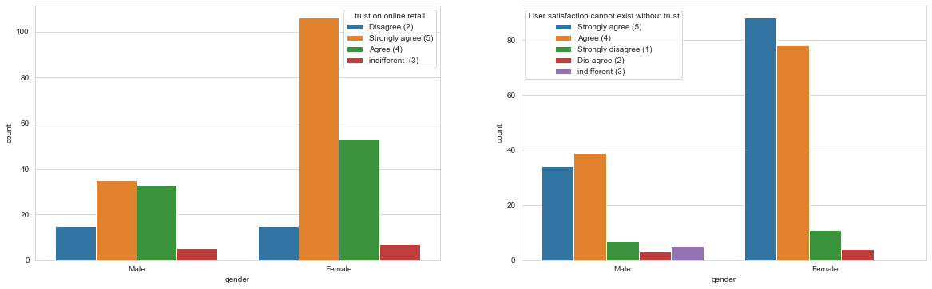
TRUST AND GENDER
•Trust and commitment are the central tenets in building successful long‐term relationships in the online retailing context. Here female respondents strongly agree that trust is an important factor for successful customer retention
•Most of the Male Respondent doesn't agree that user satisfaction cannot exist without trust.But seeing female respondent view it is complete reciprocal to the male respondent view.over 85 female users agree that trust is the main factor for user satisfaction.

Slide 26
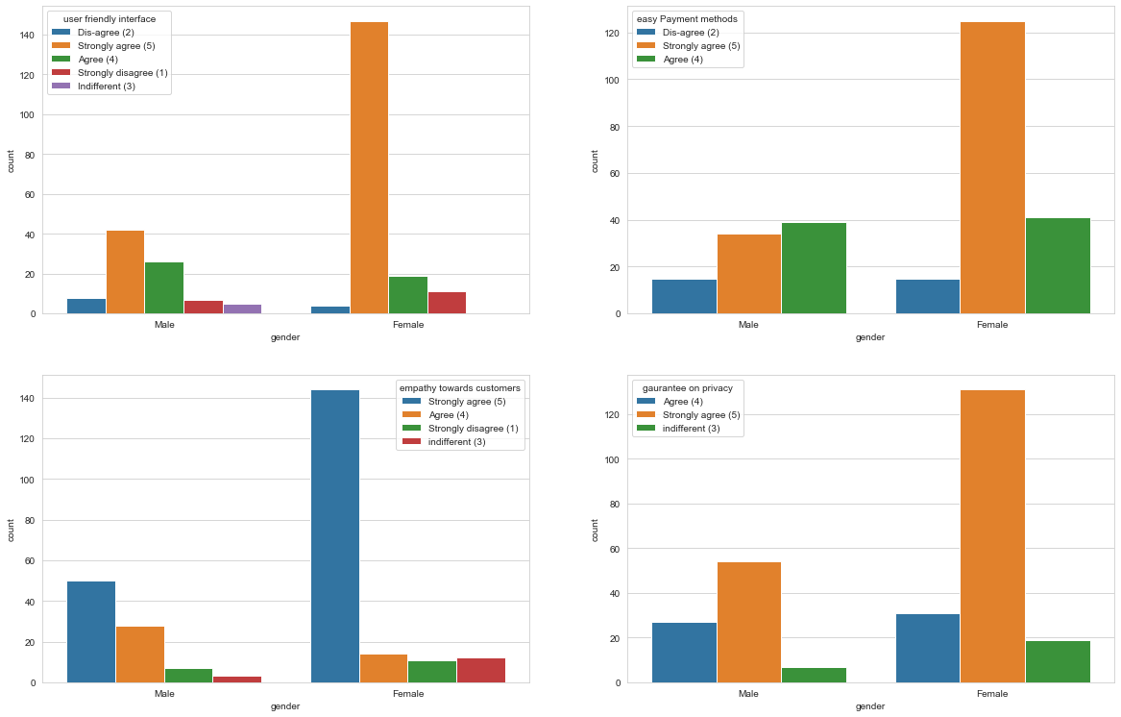
SERVICE QUALITY AND GENDER
•Among the respondents,female customers strongly agrees to the fact that the E-retail Shopping must be user friendly interface. But the male Respondents does not agree much to this fact.
•Female Respondents believe that easier payment method to shop online will be best for better E-retail shopping.Around 130 female users strongly agrees this whereas only half of the male respondents w.r.t female users agrees to this.
•showing empathy helps customers to feel that their concerns matter. Female users strongly agrees that empathy towards customers will increase the trust on service quality whereas many male respondents does not agree to this point.
•Handling and protection of the sensitive personal information of the users is very important. Female respondents around 140 strongly agrees on Guarantee on privacy increase the customer retention and male respondents around 50 strongly agrees to it.

Slide 27
CATEGORICAL ENCODING
Notes:
No slide master

Slide 28
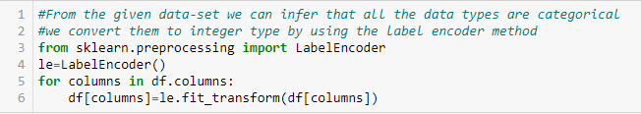
LABEL ENCODER
Label Encoding refers to converting the labels into numeric form so as to convert it into the machine-readable form
01
02
Machine learning algorithms can then decide in a better way on how those labels must be operated
03
It is an important pre-processing step for the structured dataset in supervised learning.
04
Once the Encoding is done we proceed with Feature Engineering.

Slide 29
FEATURED ENGINEERING
Notes:
No slide master

Slide 30
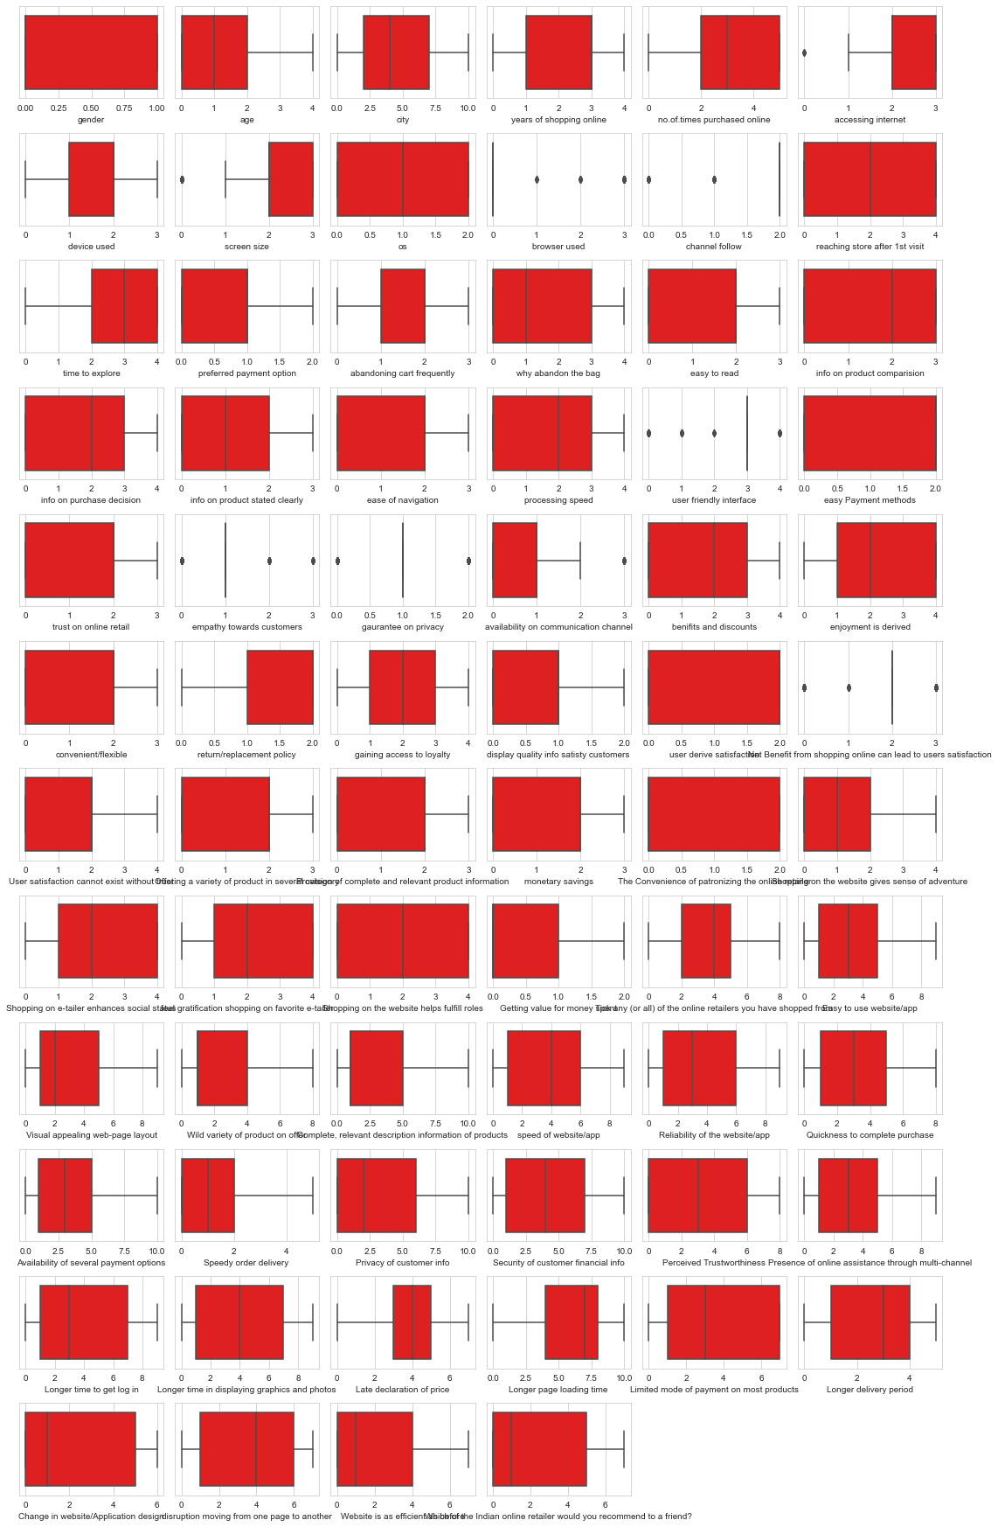
OUTLIERS

Slide 31

OUTLIER ANALYSIS
Percentage of Data Loss
loss of data=(269-249)/269*100
loss of data=7.43%
✓when we try to remove outliers it results in loss of data around 7%.
✓since the loss of data is not much as expected,so proceeding with outlier removal.

Slide 32
CONCLUSION
POINT 1
Exploratory data analysis is one of the key competencies of a data scientist at a startup. We should be able to dig into a new data set and determine how to improve our product based on the results.
POINT 2
EDA is a way of understanding the shape of a data set, exploring correlations within the data, and determining if there’s a signal for modeling an outcome based on the different features.
POINT 3
Here we have done the EDA for the given data set. From here we can proceed with train test split and predict using Machine learning algorithm

Slide 33
THANK YOU!
ANY QUESTIONS?

